Slide 1

MASTER’S DEGREE IN COMPUTER ENGINEERING
QUANTUM COMPUTING AND QUANTUM INTERNET
PROJECT DISCUSSION
E91 PROTOCOL
PROFESSORS
STUDENT
LUCIANO LENZINI
LEONARDO BACCIOTTINI
GIOVANNI LIGATO
UNIVERSITY OF PISA

Slide 2

MASTER’S DEGREE IN COMPUTER ENGINEERING
QUANTUM COMPUTING AND QUANTUM INTERNET
PROJECT DISCUSSION
E91 PROTOCOL
PROFESSORS
STUDENT
LUCIANO LENZINI
LEONARDO BACCIOTTINI
GIOVANNI LIGATO
UNIVERSITY OF PISA

Slide 3


INTRODUCTION
MAYBE Follow:
Background
Problem statement,
Solution…
Do not represent the protocol from scratch…
INSECURE CHANNEL
EXCHANGE SECRET KEY ALICE AND BOB

Slide 4
SCENARIOS TO ANALYZE
Ideal Conditions
Channel Errors
Eavesdropping

Slide 5




CHALLENGES
THE STATE AND OBSERVABLES AND S FORMULAS USED AT THE END.
$$S= | \left\langle A_{1}B_{1} \right\rangle +\left\langle A_{1}B_{2} \right\rangle +\left\langle A_{2}B_{1} \right\rangle − ⟨ A_{2}B_{2} ⟩ |$$
$$B_{1}=\frac{Z+X}{\sqrt{2}}$$
$$A_{1} = Z$$
$$A_{2} = X$$
$$B_{2}=\frac{Z−X}{\sqrt{2}}$$

Slide 6
IDEAL CONDITIONS
RESULTS
ALL THE PLOTS required in the project specifications

Slide 7
CHANNEL ERRORS
EXPLAIN HOW THEY ARE INTRODUCED VIA THE SPECIALIZED CIRCUIT
ADD THE SCREEN OF THE CIRCUIT AND FORMULAS…
$$w⋅\left|ψ^{−}\right\rangle \left\langle ψ^{−}\right| + \frac{1−w}{4}⋅I$$
$$R_{mis}=\frac{\#mismatchedbits}{totalkeylength }$$

Slide 8
RESULTS WITH FOLLOWIN SETTING:
# Number of times the protocol is executed for each setting
n = 30
# Theta values to be used for the generation of the Werner States
theta_values = np.linspace(0, np.pi, 15)
# Whether Eve is eavesdropping or not
eavesdropping = False
# Number of EPR pairs to be generated in one execution of the protocol
epr_pairs = 300

Slide 9
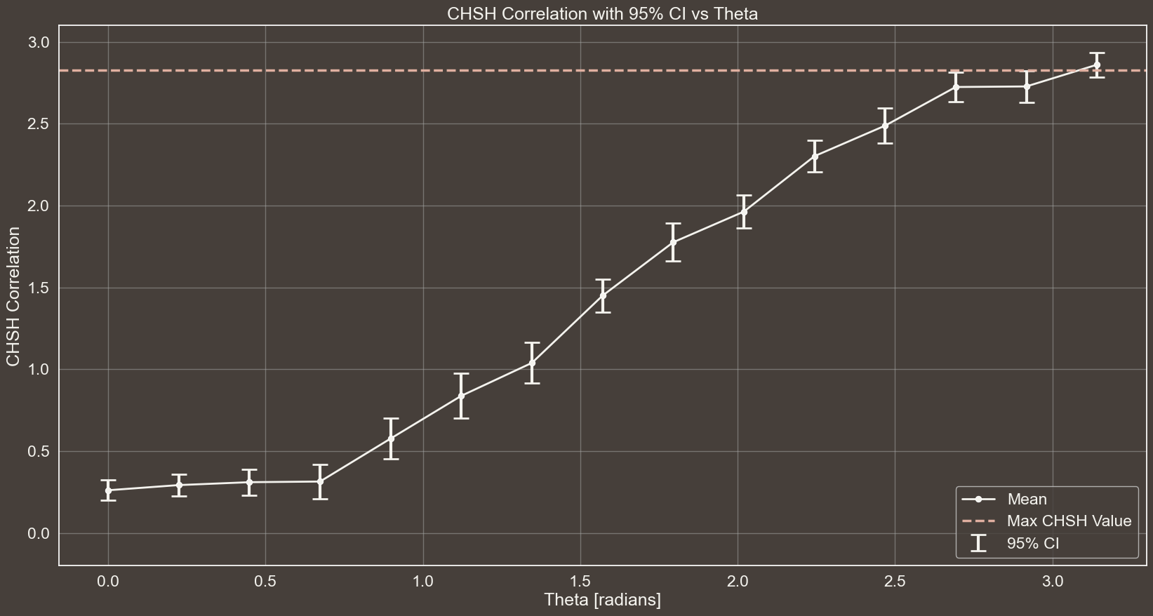
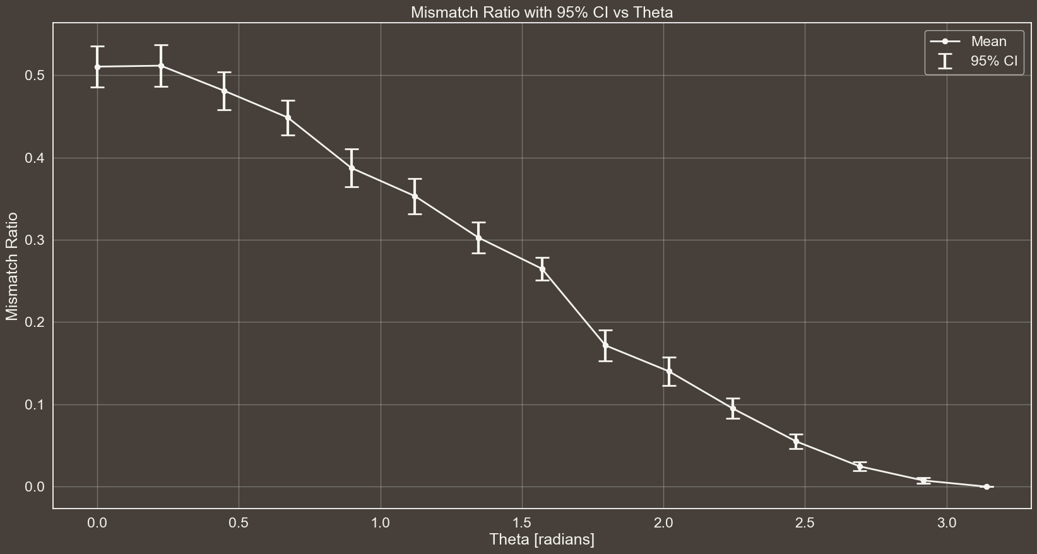

Slide 10
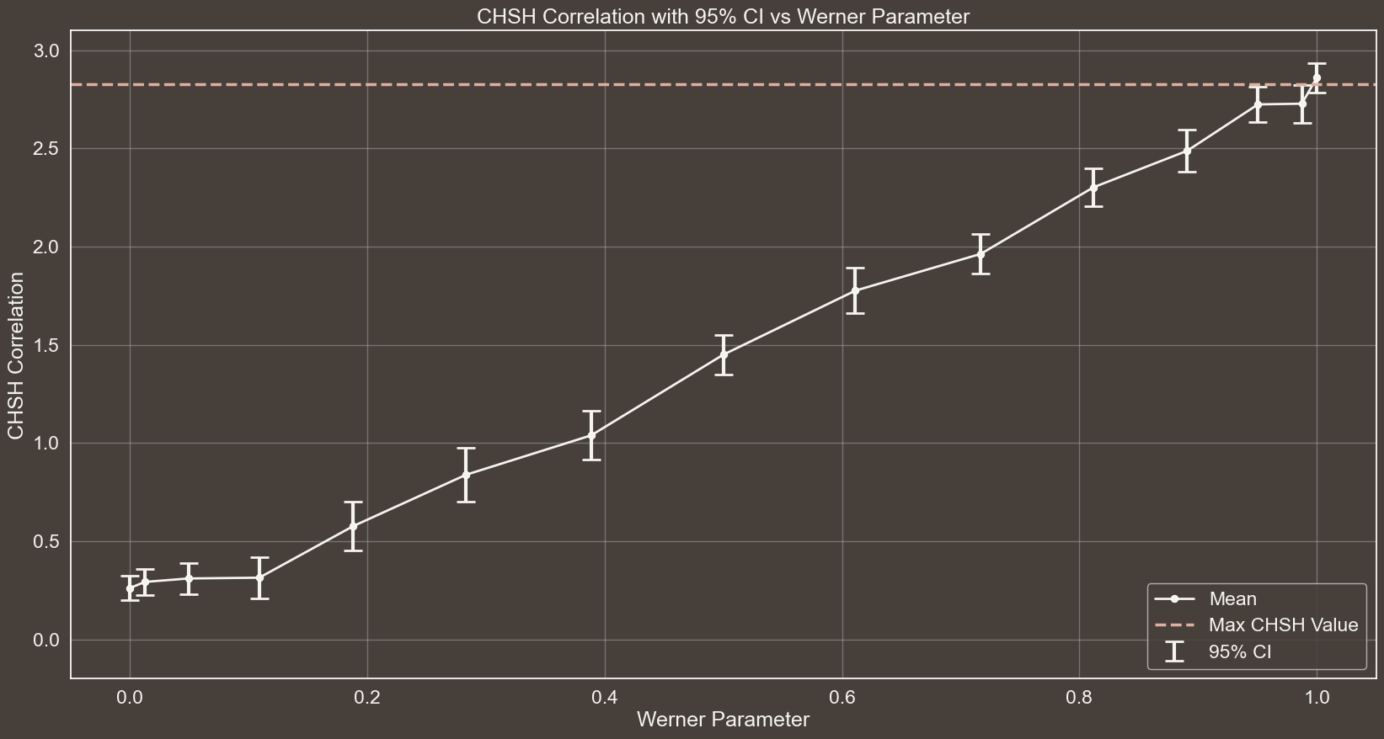
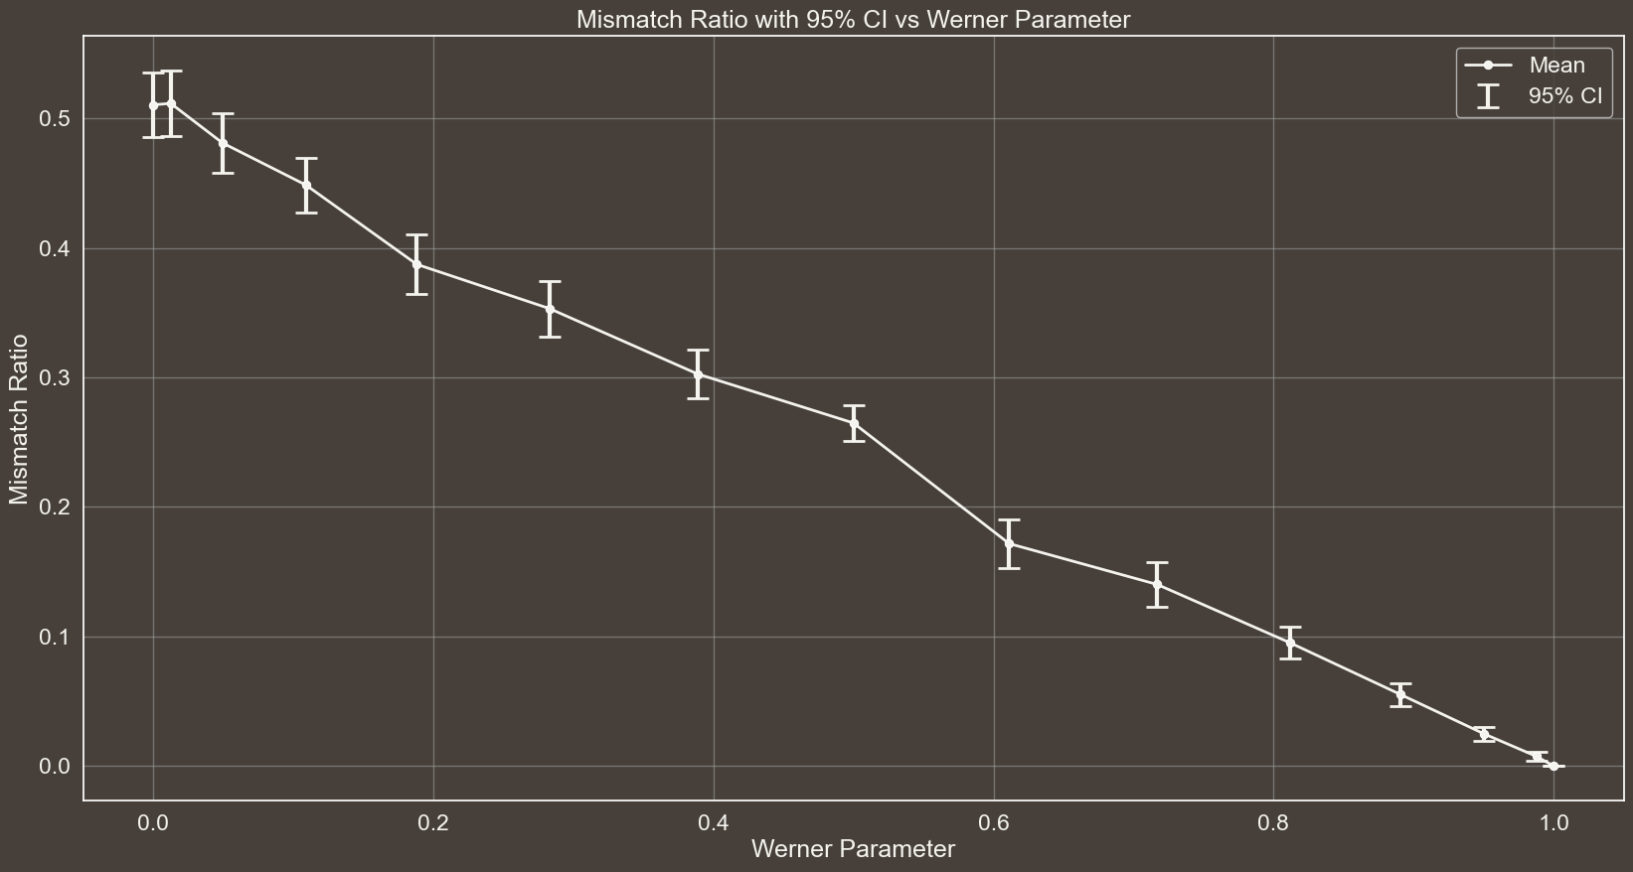

Slide 11
RESULTS WITH FOLLOWIN SETTING:
# Number of times the protocol is executed for each setting
n = 30
# Theta values to be used for the generation of the Werner States
theta_values = np.linspace(0, np.pi, 15)
# Whether Eve is eavesdropping or not
eavesdropping = False
# Number of EPR pairs to be generated in one execution of the protocol
epr_pairs = 1000

Slide 12
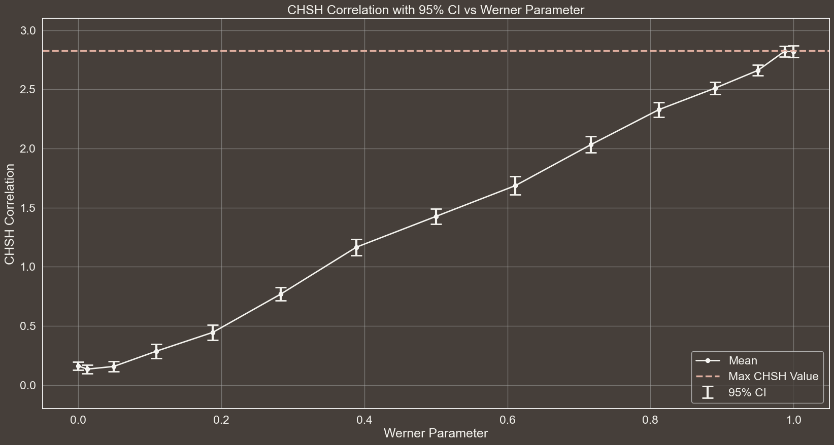
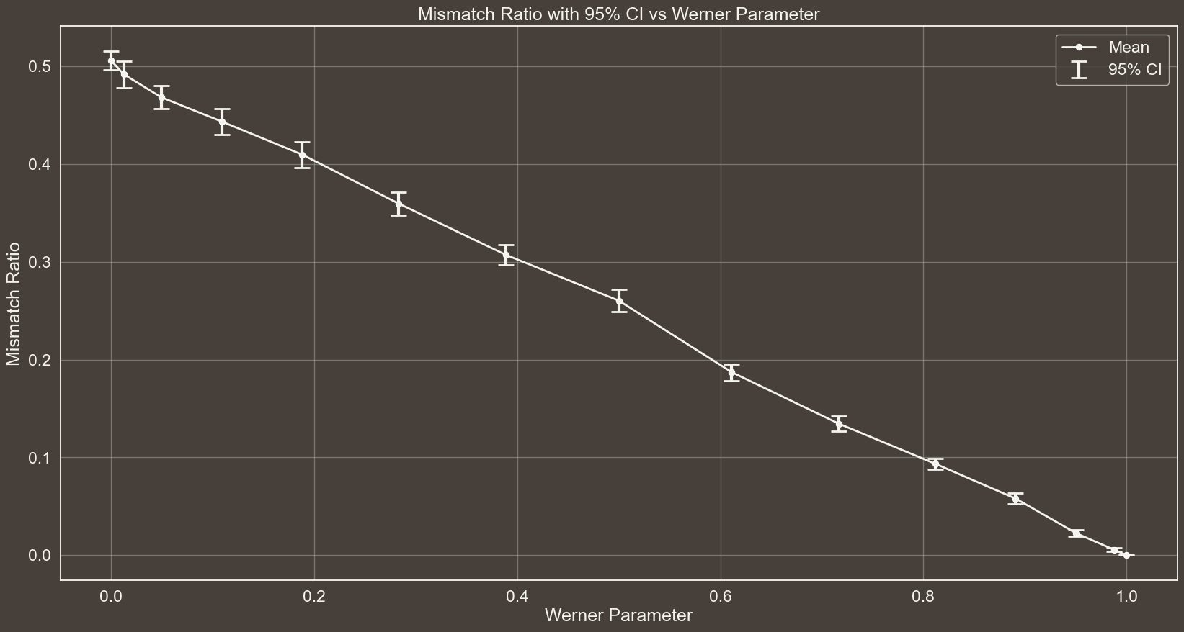

Slide 13
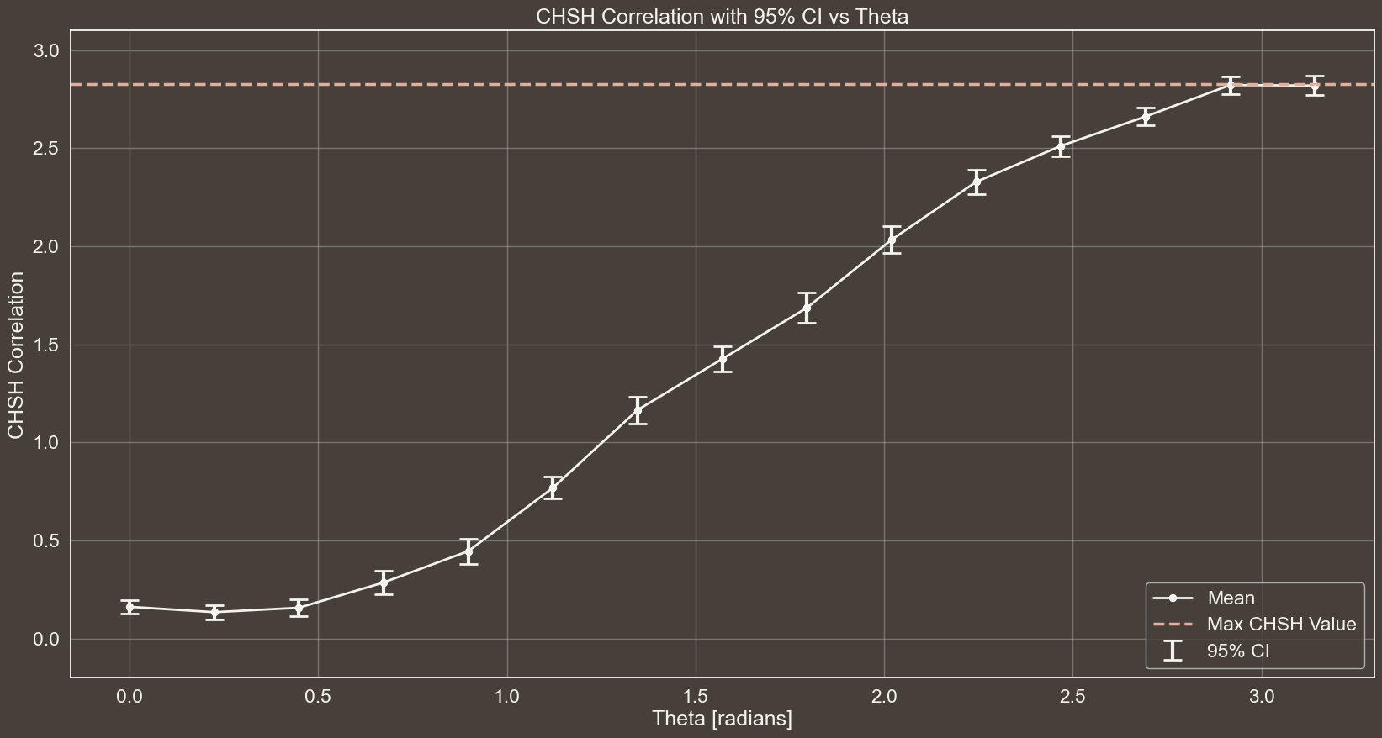
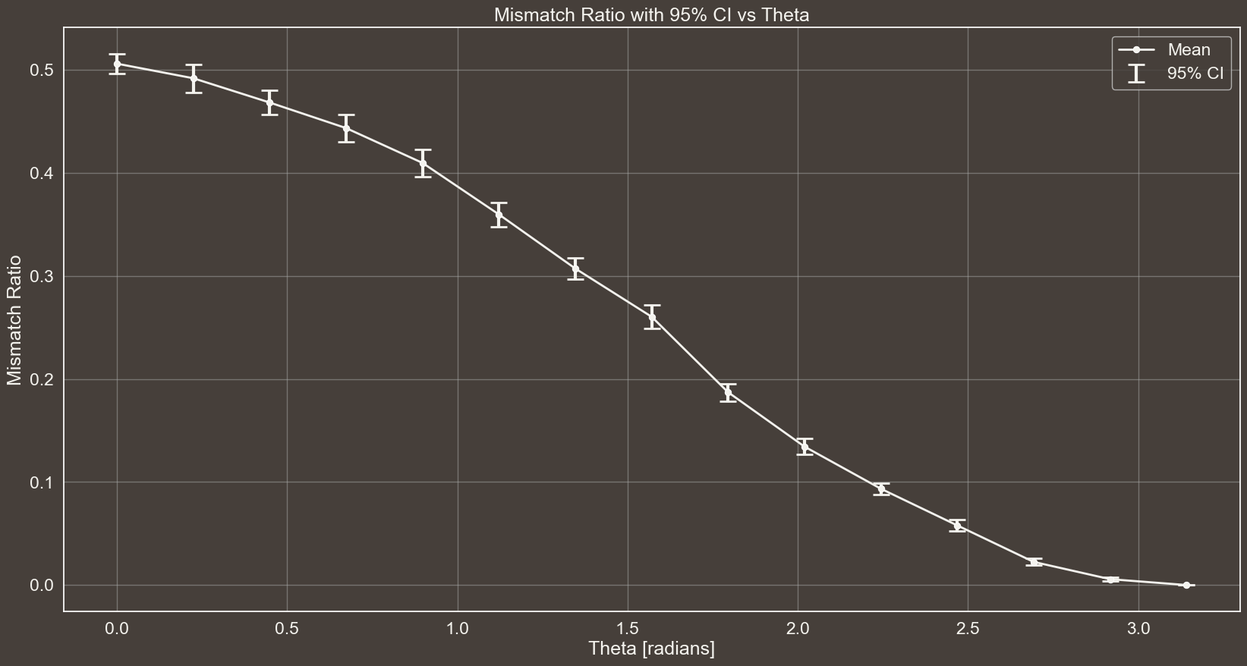

Slide 14
RESULTS WITH FOLLOWIN SETTING:
# Number of times the protocol is executed for each setting
n = 30
# Theta values to be used for the generation of the Werner States
theta_values = np.linspace(0, np.pi, 15)
# Whether Eve is eavesdropping or not
eavesdropping = False
# Number of EPR pairs to be generated in one execution of the protocol
epr_pairs = 80

Slide 15
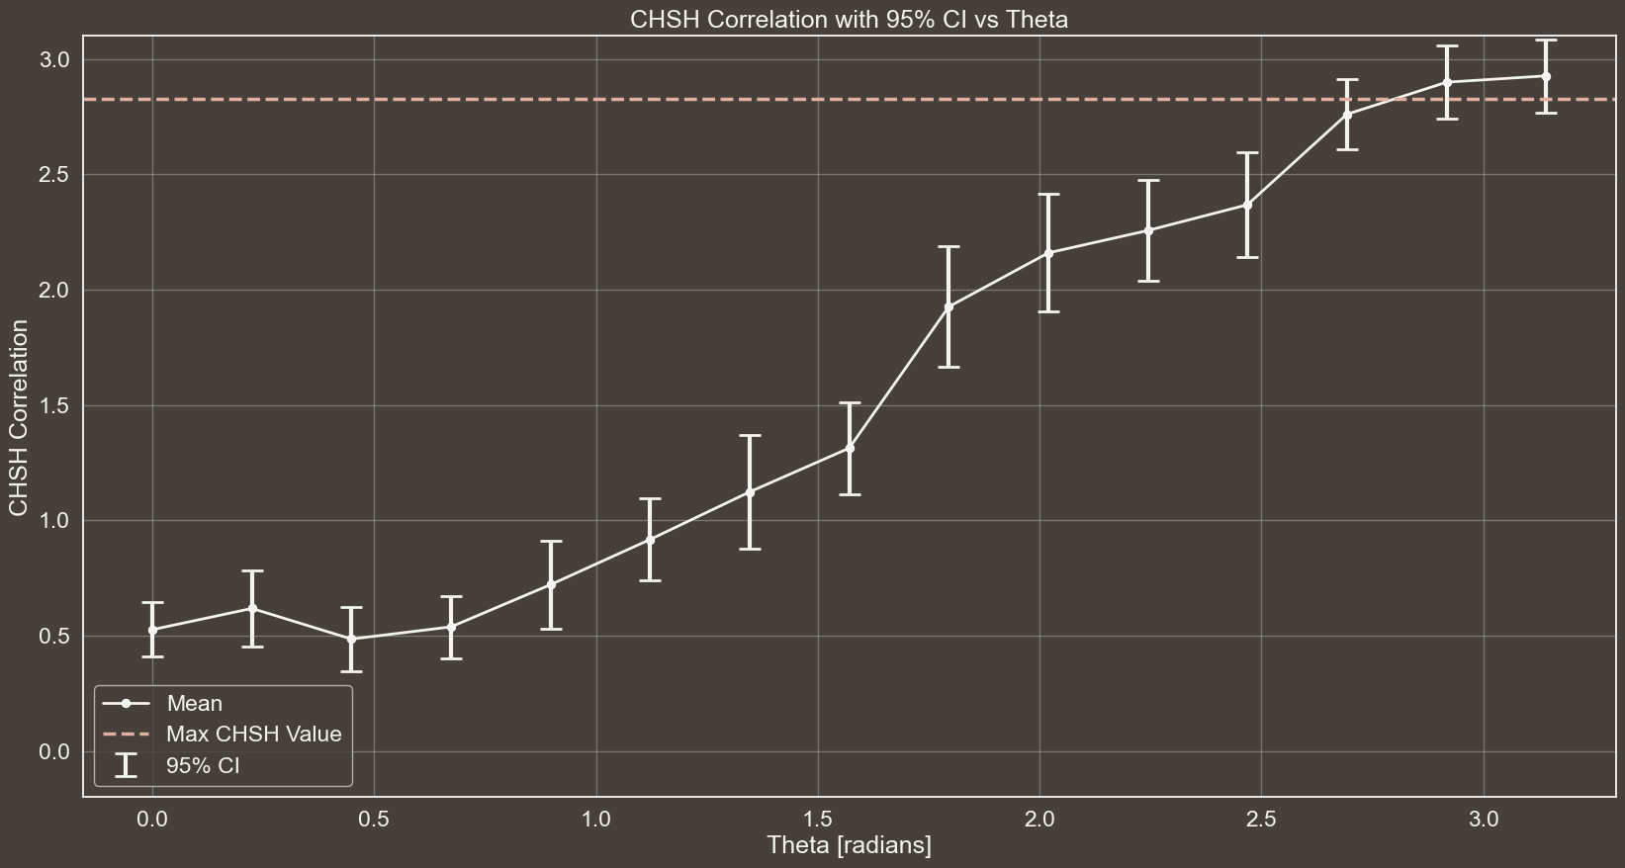
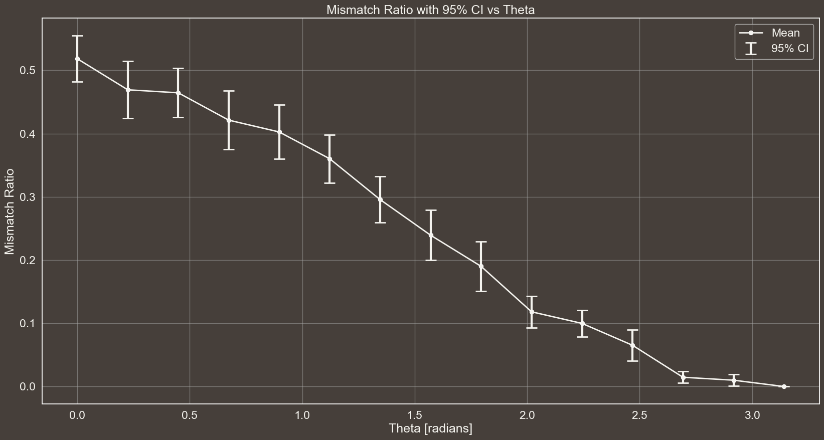

Slide 16
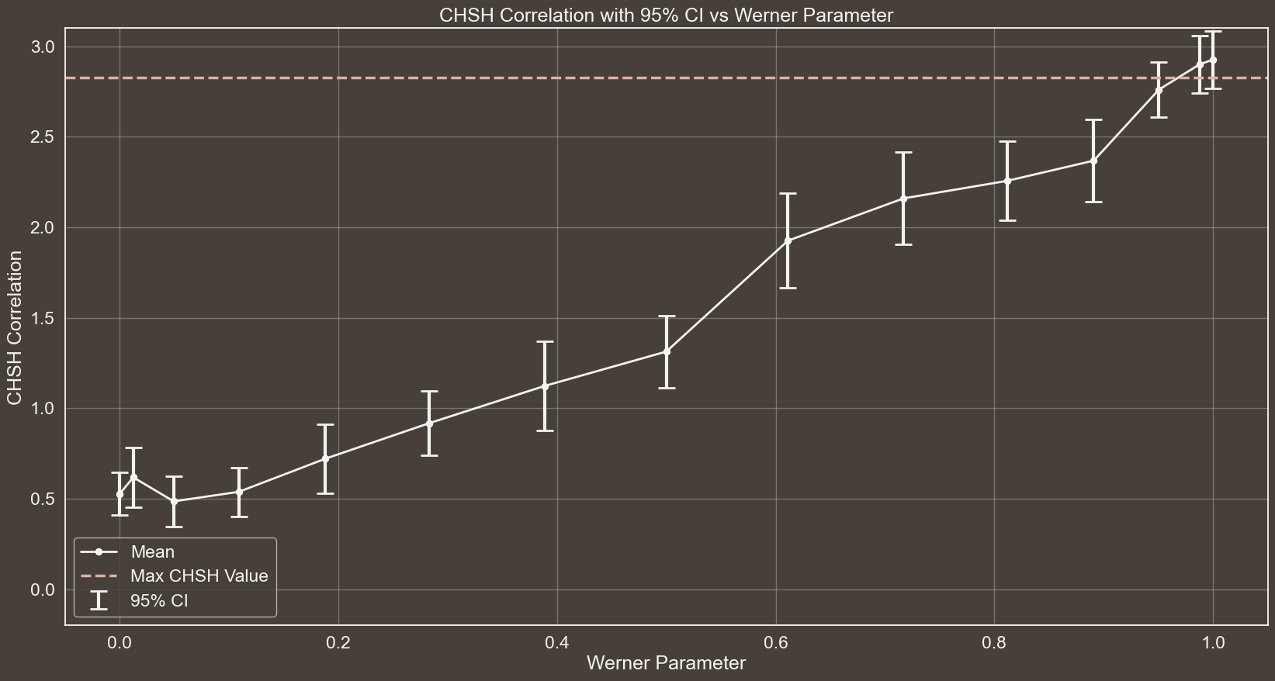
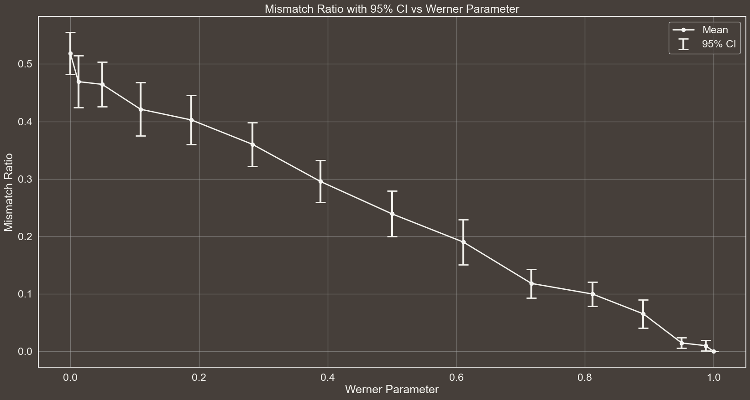

Slide 17
RESULTS WITH FOLLOWIN SETTING:
# Number of times the protocol is executed for each setting
n = 30
# Theta values to be used for the generation of the Werner States
theta_values = [np.pi] # np.linspace(0, np.pi, 15)
# Whether Eve is eavesdropping or not
eavesdropping = True
# Number of EPR pairs to be generated in one execution of the protocol
epr_pairs = 300

Slide 18
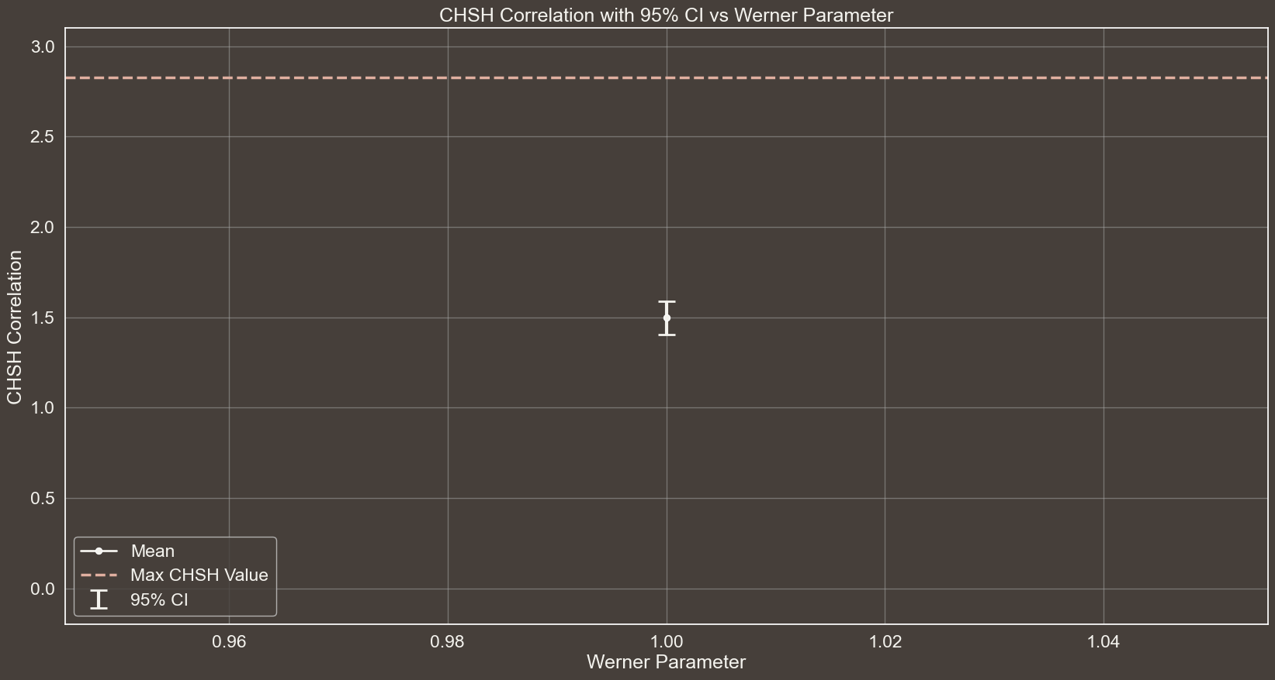
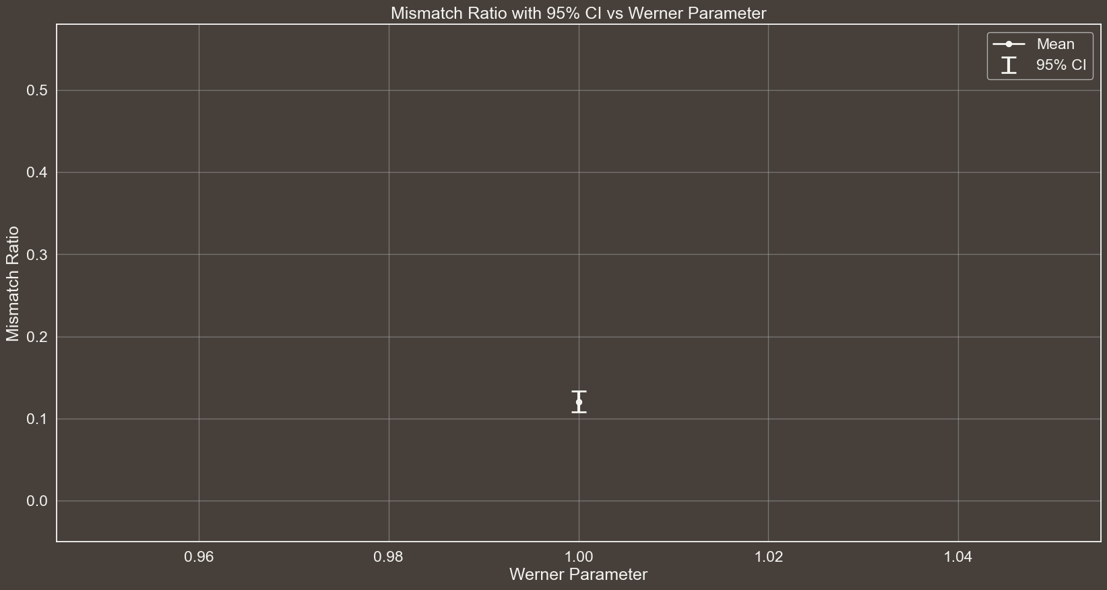
Spiegare a cosa sono dovuti gli errori in questo caso… Il fatto che se misuro in base W e ho 01 o 10 allora posso ottenere tutti gli outcome con diverse probabilità

Slide 19



EAVESDROPPING
GRAPH OF S WITH CI THAT IS BELOW 2sqrt(2)
$$\left|ψ^{−}\right\rangle →$$
$$|01⟩$$
$$\frac{1}{2}$$
$$|10⟩$$

Slide 20
THANKS
FOR YOUR ATTENTION

Slide 21

MASTER’S DEGREE IN COMPUTER ENGINEERING
INTELLIGENT SYSTEMS
PROJECT DISCUSSION
Comparative Analysis of Deep Learning Models for Brain Tumor Segmentation in MRI Images
PROFESSORS
STUDENT
PIETRO DUCANGE
FABRIZIO RUFFINI
GIOVANNI LIGATO
University of Pisa

Slide 22

Brain Tumors directly impair Brain function, affecting cognition, mood and personality.
Timely detection of these Tumors is crucial, as recognizing the initial stages of a Brain Tumor can profoundly influence a patient’s prognosis.
BACKGROUND
Reading and interpreting MRI scans is an intricate process. Indeed, it is estimated that in 5-10% of scans, a relevant Pathology is missed.
THE PROBLEM
Intelligent Systems to automatically identify and segment Regions Of Interest (ROI).
SOLUTION

Slide 23
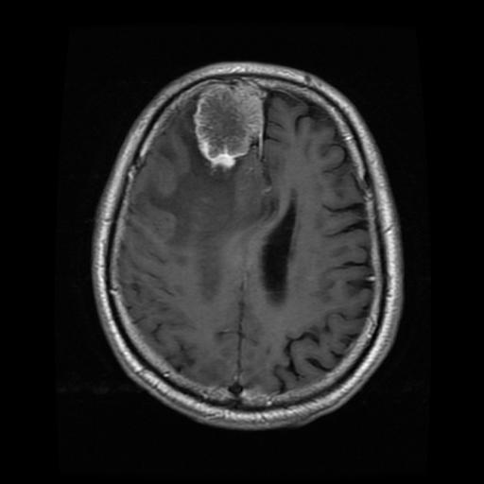


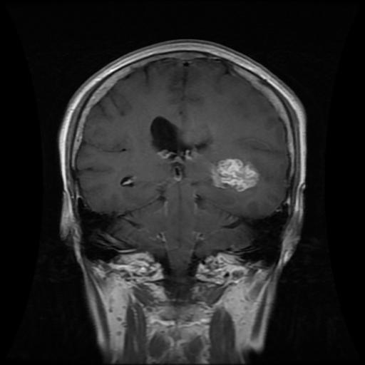


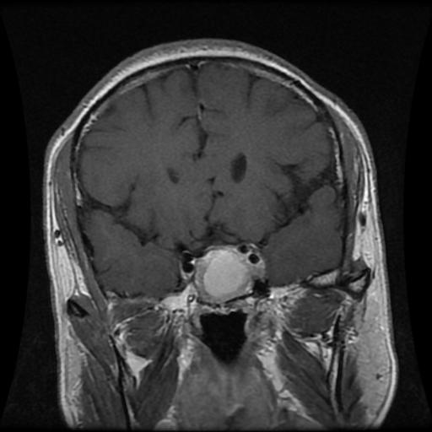


DATASET
MENINGIOMA
708
Collected from two Hospitals in China between 2005 and 2010.
GLIOMA
1426
233 Patients
PITUITARY
930
The Tumor regions were manually segmented by three experienced radiologists.

Slide 24


YOLOv8n-seg 3.4
YOLOv8s-seg 11.8
YOLOv8
YOLOv8m-seg 27.3
YOLOv8l-seg 46.0
YOLO
YOLOv8x-seg 71.8
DEEP LEARNING MODELS
YOLOv9c-seg 27.9
YOLOv9
YOLOv9e-seg 60.5
U-Net
1.94
Region Growing
0
CLASSICAL ALGORITHM
THIS COLOR SHOWS THE MODEL'S COMPLEXITY IN MILLIONS OF PARAMETERS

Slide 25
MAIN
.
2 | X ∩ Y |
EVALUATION
=
DICE SCORE
METRIC
| X | + | Y |
It measures the similarity between two samples and is used to compare algorithm outputs against reference masks, particularly in medical applications.

Slide 26




EXPERIMENTAL ANALYSIS
WORKFLOW
DATASET PREPARATION
TRAINING
RESULTS
5 FOLD CROSS-VALIDATION

Slide 27
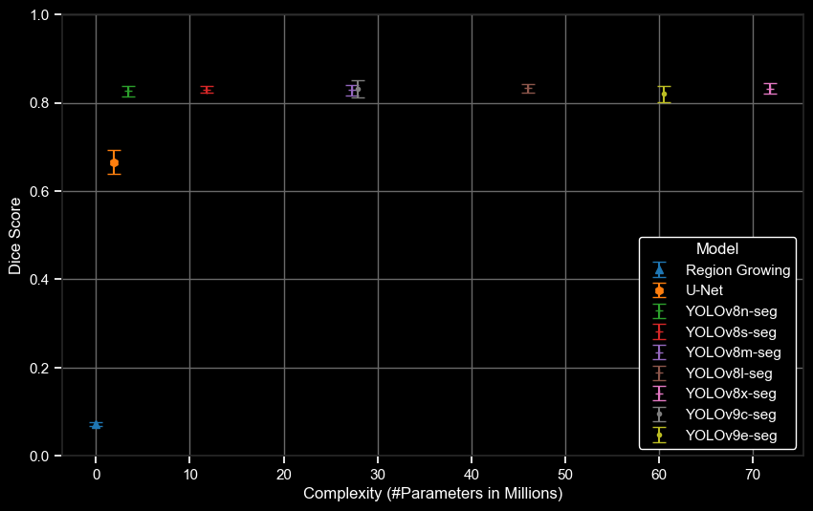
SEGMENTATION RESULTS
Dice Score
Complexity (#Parameters in Millions)

Slide 28
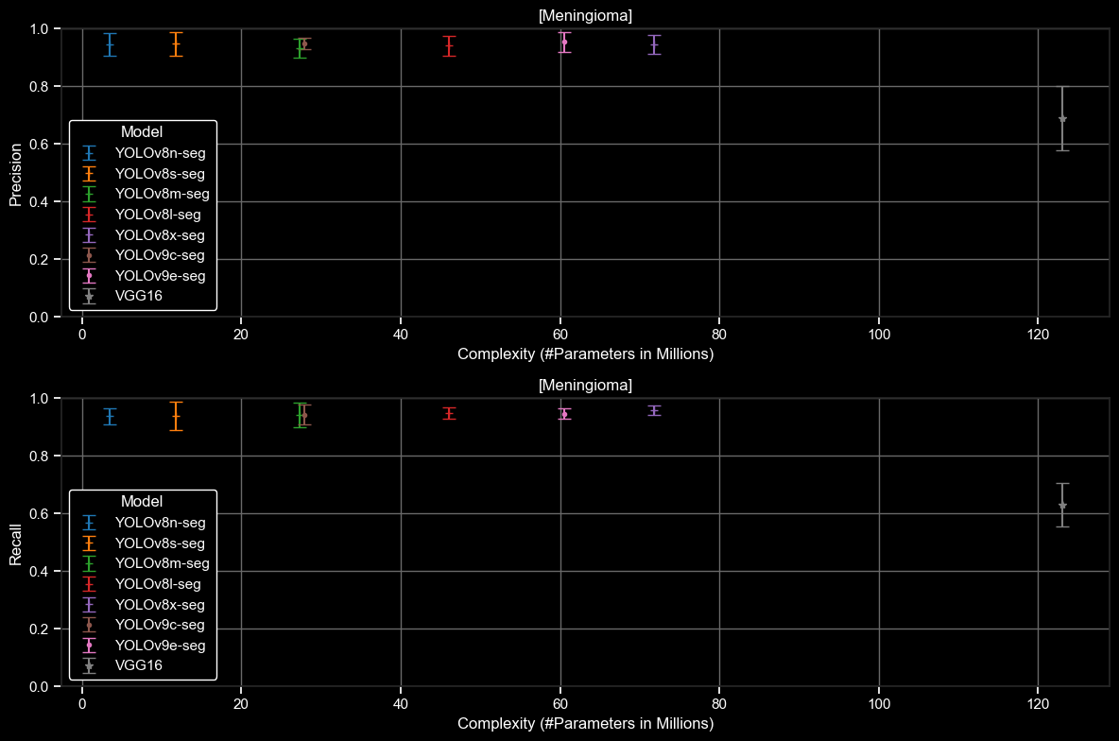
CLASSIFICATION RESULTS
MENINGIOMA

Slide 29
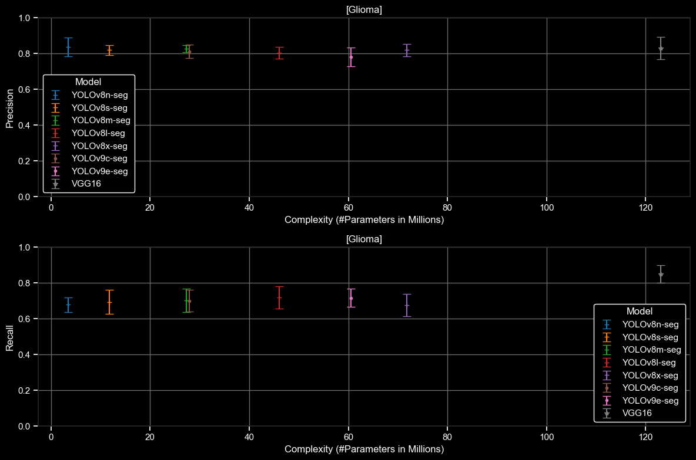
CLASSIFICATION RESULTS
GLIOMA

Slide 30
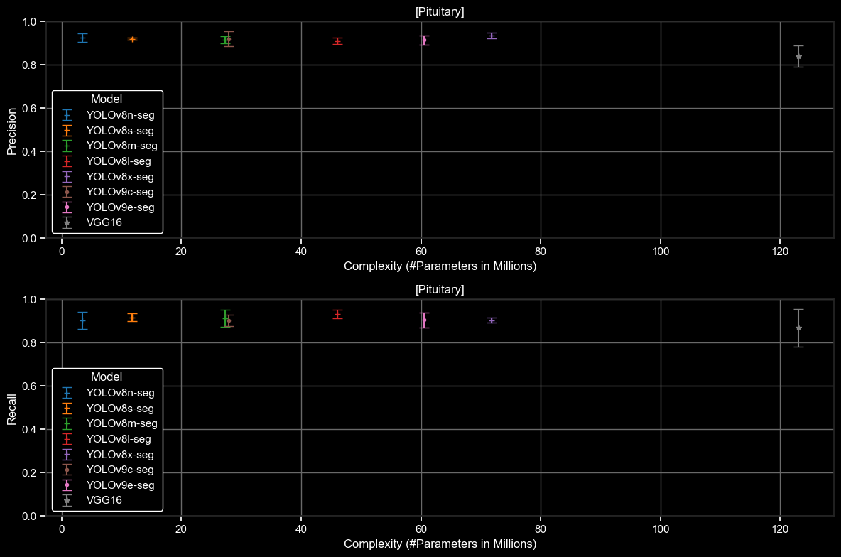
CLASSIFICATION RESULTS
PITUITARY

